Slide 1

Student Performance Analysis
Vaishnavi Dacharaju
1309564

Slide 2
About Data
This data is about approaching student achievement in secondary education of two Portuguese schools.
The data attributes include student grades, demographic, social and school related features) and it was collected by using school reports and questionnaires.
Two datasets are provided regarding the performance in two distinct subjects: Mathematics (mat) and Portuguese language (por).

Slide 3
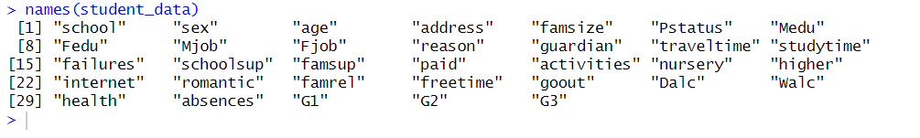
About Data:
The dataset has 32 entities or data points. Those are listed below:

Slide 4

Data Pre-Processing:
As the first step of pre-processing, I have taken out the null values from my dataset.
FixNull <- function(attribute) { ifelse(is.na(attribute), mean(attribute, na.rm = TRUE), attribute) } student_data$famsize <- FixNull(student_data$famsize) student_data$Medu <- FixNull(student_data$Medu)

Slide 5
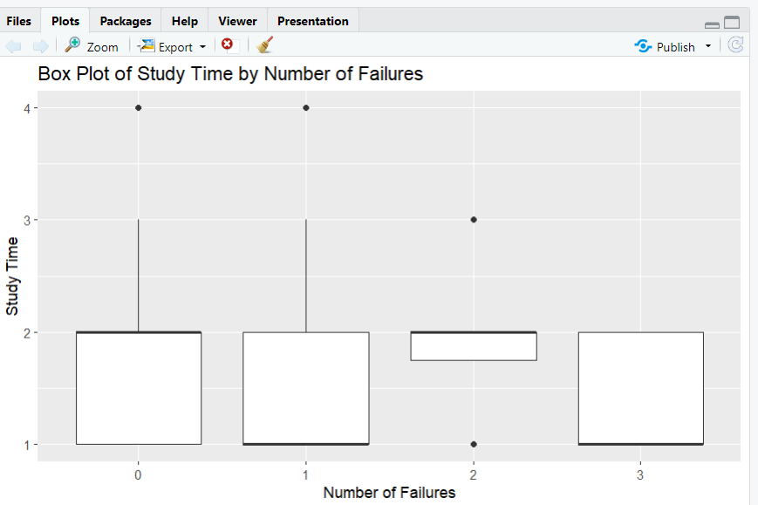
Data Visualization
Box Plot: The Box plot analysis between the study time and failures is given below Output:
# Box Plot: Study time by number of failures ggplot(student_data, aes(x = factor(failures), y = studytime)) + geom_boxplot() + labs(title = "Box Plot of Study Time by Number of Failures", x = "Number of Failures", y = "Study Time")

Slide 6
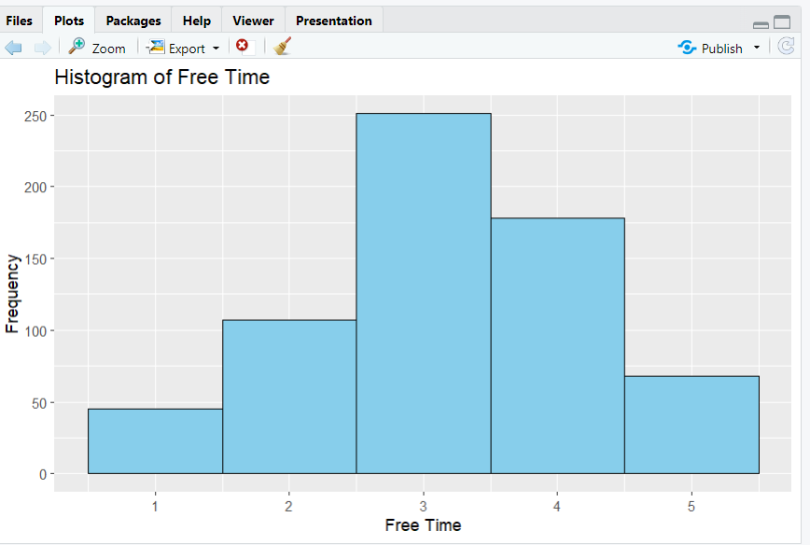
Data Visualization:
Histogram:This histogram illustrates the distribution of free time among students.
Input: ggplot(student_data, aes(x = freetime)) + geom_histogram(binwidth = 1, fill = "skyblue", color = "black") + labs(title = "Histogram of Free Time", x = "Free Time", y = "Frequency")

Slide 7
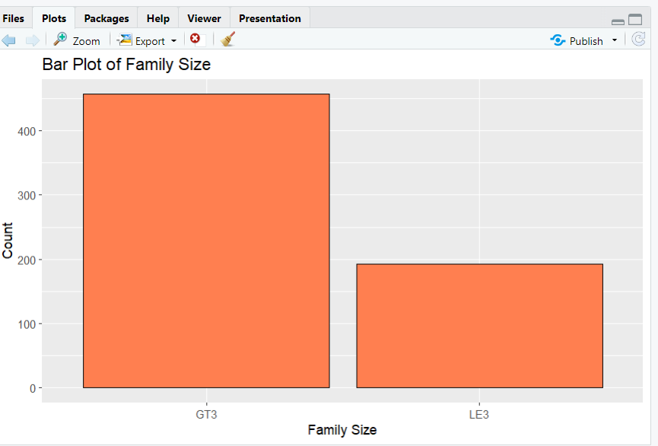
Data Visualization
Bar Plot:This bar plot displays the counts of different family sizes in the dataset.
Input:
# Bar Plot: Counts of Family Size ggplot(student_data, aes(x = famsize)) + geom_bar(fill = "coral", color = "black") + labs(title = "Bar Plot of Family Size", x = "Family Size", y = "Count")

Slide 8
Association Analysis:
Apriori Algorithm: Identified frequent itemsets and generated association rules.
Input:# Association Analysis using Apriori Algorithm itemset <- as(trainingSet[, c(3, 14)], "transactions")
# Perform Apriori analysis rules <- apriori(itemset, parameter = list(support = 0.1, confidence = 0.7))
Apriori
Parameter specification:
confidence minval smax arem aval originalSupport maxtime support minlen maxlen target ext
0.7 0.1 1 none FALSE TRUE 5 0.1 1 10 rules TRUE
Algorithmic control:
filter tree heap memopt load sort verbose
0.1 TRUE TRUE FALSE TRUE 2 TRUE
Absolute minimum support count: 39
set item appearances ...[0 item(s)] done [0.00s].
set transactions ...[5 item(s), 390 transaction(s)] done [0.00s].
sorting and recoding items ... [5 item(s)] done [0.00s].
creating transaction tree ... done [0.00s].
checking subsets of size 1 2 done [0.00s].
writing ... [0 rule(s)] done [0.00s].
creating S4 object ... done [0.00s]

Slide 9
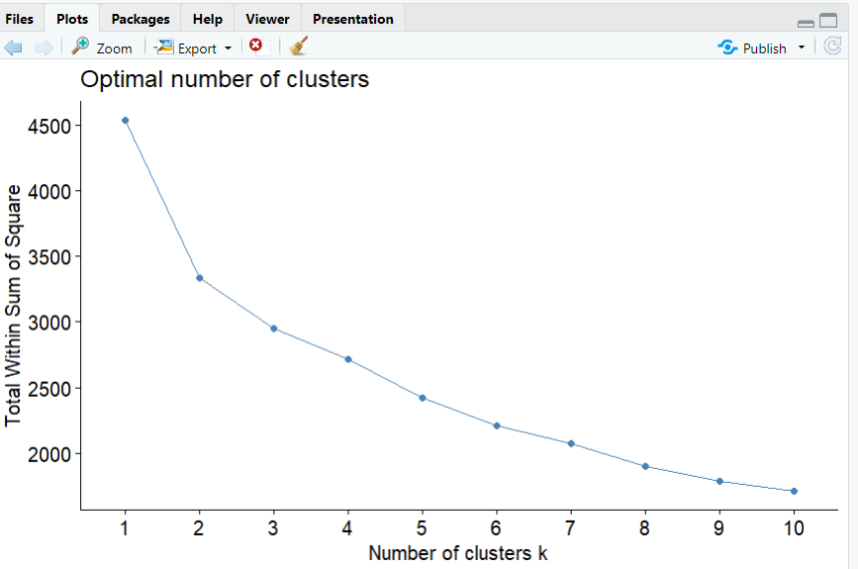
Clustering:
Elbow Method:
The "elbow point" indicates the optimal number of clusters, where adding more clusters doesn't significantly reduce WSS.
Input: fviz_nbclust(clustering_data, kmeans, method = "wss")

Slide 10
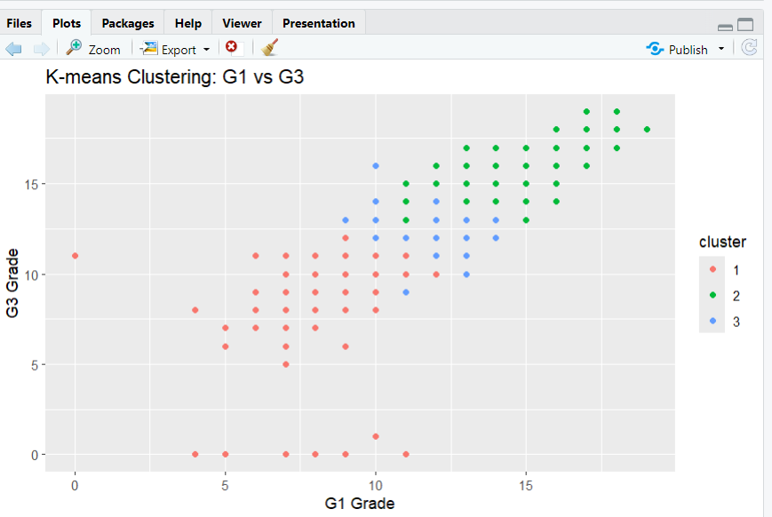
K-Mean Clustering
Input: # Scatter plot of G1 vs G3 colored by clustersggplot(student_data, aes(x = G1, y = G3, color = cluster)) + geom_point() + labs(title = "K-means Clustering: G1 vs G3", x = "G1 Grade", y = "G3 Grade")

Slide 11
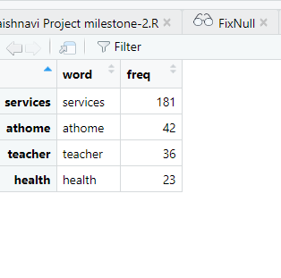
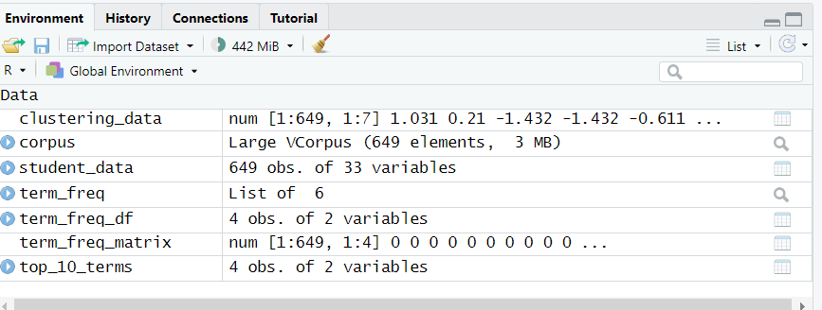
Text Mining Top 10 words
The most frequent terms in the cleaned text data are identified and displayed. These terms give insights into common words related to students' family jobs.
Input: wordcloud(words = top_10_terms$word, freq = top_10_terms$freq, min.freq = 1, scale = c(3, 0.2), colors = brewer.pal(8, "Dark2"))

Slide 12
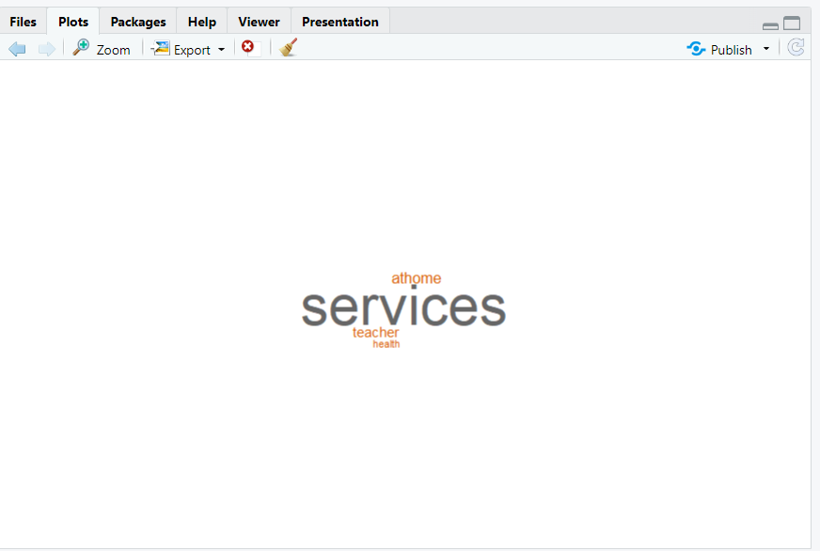
Text Mining
A word cloud visualization shows the top terms, with the size of each word indicating its frequency. This visual representation helps to quickly grasp the most common terms in the text data.
Input: wordcloud(words = top_10_terms$word, freq = top_10_terms$freq, min.freq = 1, scale = c(3, 0.2), colors = brewer.pal(8, "Dark2"))

Slide 13
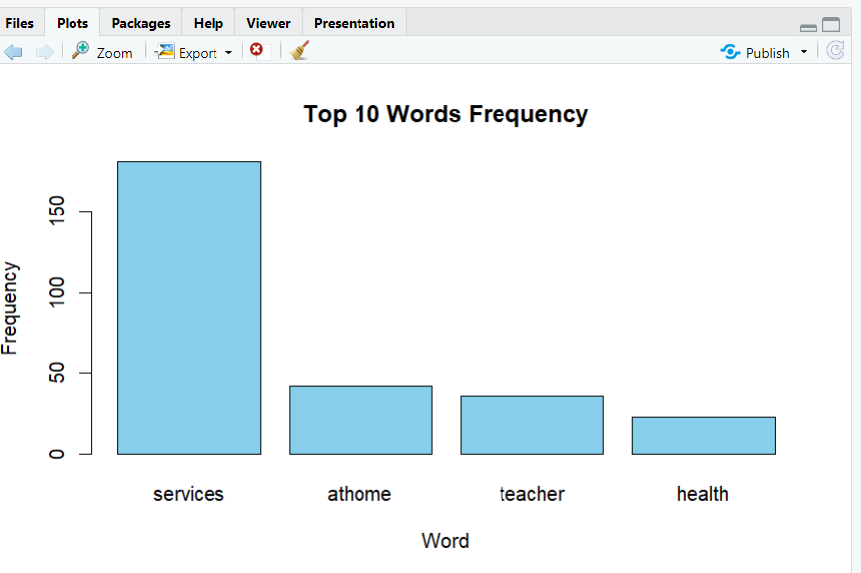
Text Mining
A bar plot shows the frequency of the top 10 words in the text data. This plot helps to quantify and compare the occurrences of the most frequent terms.
Input: # Plot word frequencies for top wordsbarplot(top_10_terms$freq, names.arg = top_10_terms$word, col = "skyblue", main = "Top 10 Words Frequency", xlab = "Word", ylab = "Frequency")

Slide 14


